Slide 1

Blood bank management system
Created by : prashant Jagtap (2926),
Dhananjay Bhagat (2912),
Bhagirath koli (2908).
Guided by : prof. midgule Vinayak e.

Slide 2
CONTENT
Introduction
Required Tools
Aims and Objective
Problem Statement
Entity Relationship Diagram
Class Diagram
Use Case Diagram
Test Cases
Data Dictionary
Snapshot
Future Enhancement
Conclusion and Recommendation

Slide 3
introduction
Blood Management System is designed for the blood bank to gather blood from various sources and distribute it to the needy people who have high requirements for it.
The software is designed to handle the daily transaction of the blood bank and search the details when required.
It also helps to register the details of donors , blood collection details as well as blood issue reports.
The software is designed in a such a manner that it can suit the needs of all the blood bank requirements to the course of future.

Slide 4
Required tools
Operating System :- Linux
Front End :- HTML, CSS,PHP
Back End :- PostgreSQL
Technology :- XAMPP Server

Slide 5
Aims and objective
The main aim of the project is to have save the lives of people providing blood. We aim to bridge the gap between blood donors and requestors. We’ll be displaying the donors. The major problems in old Blood Banking System was that they don’t follow the actual of users.
Traditional blood banking system were developed by a 1 or 2 perspectives. This application is providing each entity the facility to approach nearby blood donors so that it will become much easier to search rare blood groups in the hour of need.

Slide 6
Problem statement
Scarcity of rare blood group.
Unavailability of blood during emergency
Less awareness among people about blood donation and blood transfusion.
Deaths due to lack of blood during Operations.
The Blood Bank Management System project aims to make all the procedures automated and therefore with computer system it can be more fast and accurate.
This project is a high quality software to manage all these Cumbersome jobs.

Slide 7
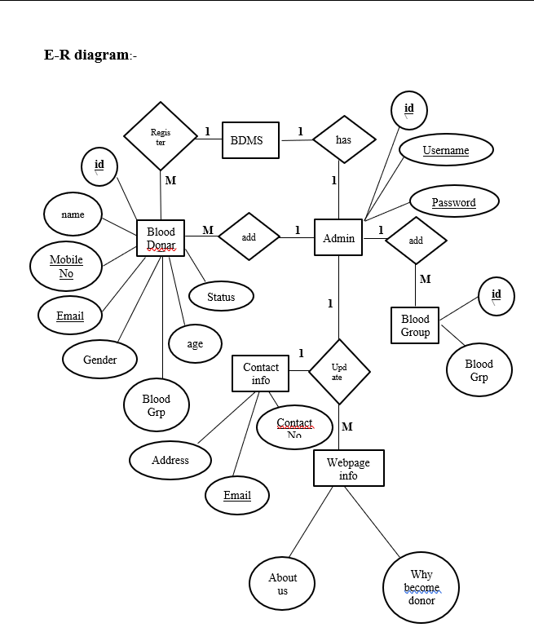
ENTITY RELATIONSHIP DIAGRAM

Slide 8
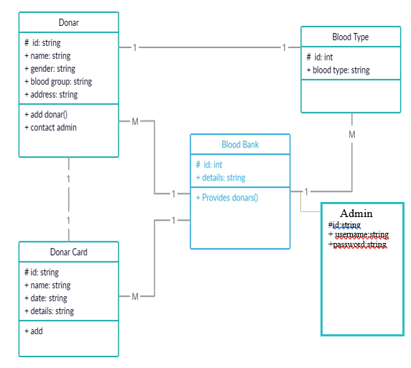
CLASS DIAGRAM

Slide 9
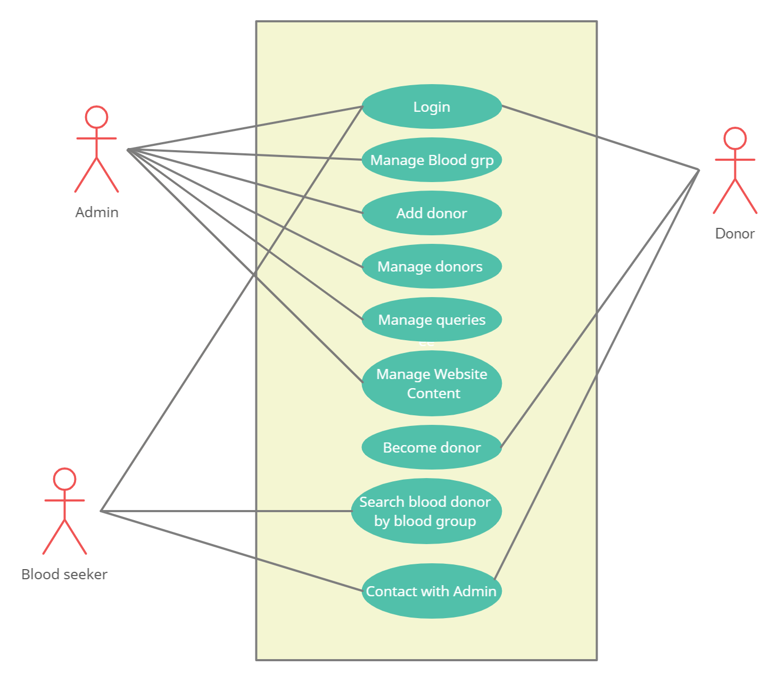
USE CASE DIAGRAM

Slide 10
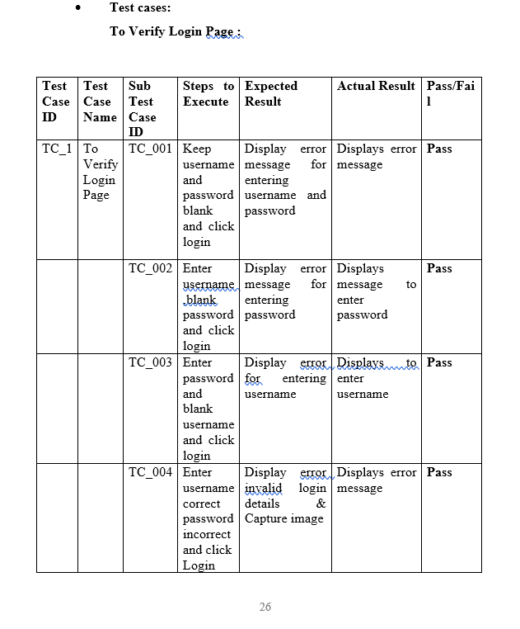
TEST CASES :

Slide 11
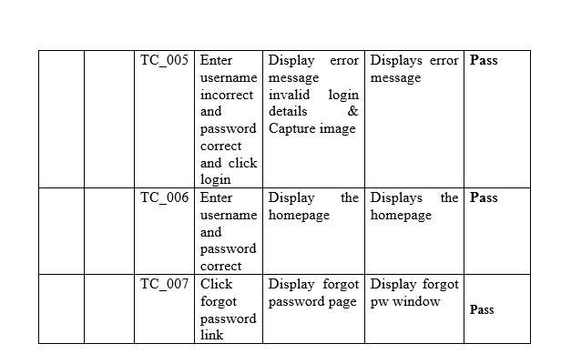

Slide 12
DATA DICTIONARY
Admin :
Field name | DataType | Constraints | Size | Description
admin_id | Int | Primary key | 15 | Unique id of admin
admin_name | Char | Not null | 30 | Name of admin
admin_password | Varchar | Not null | 15 | Password of admin
Blood group :
Field name | Data Type | Constraints | Size | Description
Donor_id | Int | Primary key | 30 | Donor id
Blood group | Varchar | Not null | 20 | Blood group of donor
Posting date | Date | Not null |  | Date of posting

Slide 13
Field name | DataType | Constraints | Size | Description
Donor_id | Int | Primary key | 30 | Donor id
Donor_name | Varchar | Not null | 20 | Name of Donor
Donor_email | Varchar | Not null | 20 | Email id of donor
phoneNo | Numeric | Not null | 10 | Phone number
Gender | Varchar | Not null | 20 | Donor gender
Age | Int | Primary key | 11 | Age of donor
Blood group | Varchar | Not null | 20 | Blood group of donor
Address | Varchar | Not null | 255 | Address of donor
Message | Varchar | Not null | 100 | Message
Posting date | Date | Current time |  | Date of posting
Status | Int | Foreign key | 1
Blood Donor :

Slide 14
SNAPSHOTS

Slide 15
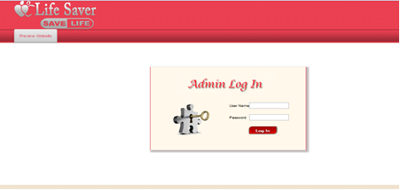
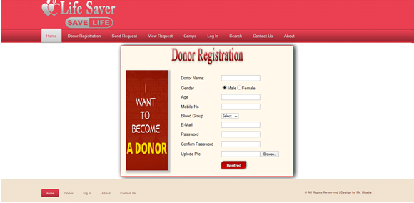
LOGIN :
REGISTRATION :

Slide 16
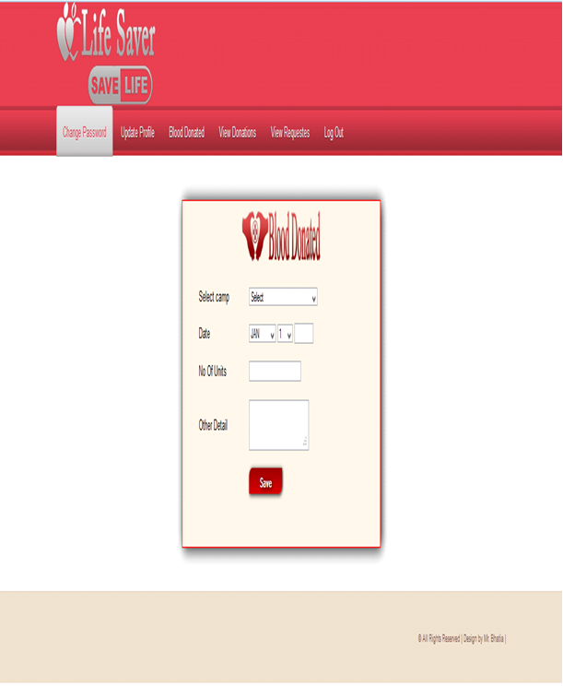
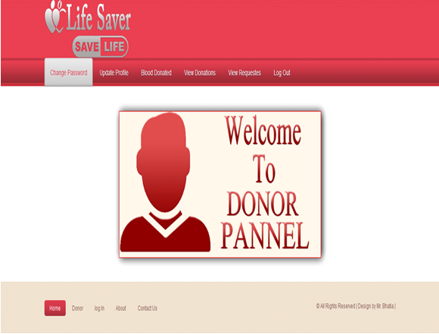
Blood Donated :
Donor Pannel :

Slide 17
Future enhancement
The System has adequate scope for modification in future if it is necessary.
As there was a little number of contact person’s information given, some people may face difficulty in getting blood fast. So we like to gather more information regarding the contact persons in other cities as well as villages and will provide much more services for the people and help everyone with humanity.
Create a Chat box to directly connect blood seekers with blood donors.

Slide 18
Conclusion and recommendation
In this project, “BLOOD BANK MANAGEMENT SYSTEM” we have tried to computerize various processes of Blood Bank . Blood Bank Management System is very flexible software and can be used in any branch of BLOOD BANK for keeping record. In this software we have tried to provide all the Blood bank management system related record keeping facilities which helps to keep record and employees who belongs to it.
The main focus of this project is to less in human efforts. The maintenance of the record is made efficient, as all the records are stored in the SQL database.
It is user interactive and effective than the existing system. The flexibility of visual basic helps to maintain the “BLOOD BANK MANAGEMENT SYSTEM” more efficiently.
Finally, we are thankful to all the people who have given us their hearty support in this endeavour

Slide 19
Thank You

